Slide 1

Pizzaz.com Analysis
Speed Dating Analytics & Online Dating Optimization
Natalie LePera | 24 Apr 2025

Slide 2
Introduction

Slide 3

What Makes Pizzaz.com Unique?
Real-World Data for Real-World Matches
Real-world data from in person speed dating events is leveraged to enhance user experience and improve match compatibility.
Predictive Matching Systems
Predictive matching is utilized to offer users high-quality potential matches based on gender specific identified preferences.
Overall Goals
Gender-specific prediction model creation allowing for improved personalization in potential matches
Real world data driven preference rankings add a pseudo peer-review of a dater’s perceived characteristics
User customization options allow for tailored match results based on the user’s preferences

Slide 4

Proposed User Customization Features
Dater Characteristics Rankings
Users can first record their rankings through an initial review period. Their rankings of sample profiles are recorded to contribute to the overall characteristic data for the user pool.
Like Score Cutoff
Users can select a like score cutoff to filter potential matches, enhancing their experience.
Attractiveness
Fun Score
Sincerity
Shared Interests
Intelligence
Ambitiousness

Slide 5
Speed Dating Data Overview

Slide 6

Data Collection and Characteristics
Participant Demographics
276 heterosexual couples, randomly matched for a short speed date
General demographics collected: Age & Race
Characteristic Ratings
Participants rated their matched partners on key characteristics
Attractiveness, sincerity, intelligence, fun, ambitiousness, & shared interests
Rankings captured in a 1 – 10 scale (1 = lowest / 10 = highest)
Second Date Rankings
Participant interest in a second date (1 = Yes 2nd date / 0 = No 2nd date)
Assumed partner's interest in a second date (1 – 10 scale; 1 = lowest likelihood / 10 = highest likelihood)
Data export errors omitted these rankings from utilization
Recommendations for future use included in further sections

Slide 7
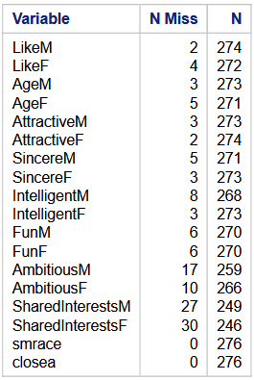
Missing Values and Summary Statistics
Identification of Missing Values
Analysis revealed numerous missing values in the dataset, captured in Table 1
Implications and recommendations discussed in later sections
Dater Demographic Similarities
56.16% of pairs were identified to be of the same race
43.84% of pairs were considered close in age.
(Close age: ages within 2 years of one another)
Correlation Findings
Correlation was calculated to determine potential impact of dater demographic similarities on reported ‘like’ scores.
Less than 0.10 correlation between race match & reported ‘like’ scores
Less than 0.02 correlation between age gap & reported ‘like’ scores
These low correlation values indicate dater age gaps and race did not significantly affect reported 'like' scores.
Table 1: Count of missing vs populated values in speed dating data
N Miss = number of missing observations
N = number of complete observations

Slide 8
Model Creation and Analysis

Slide 9
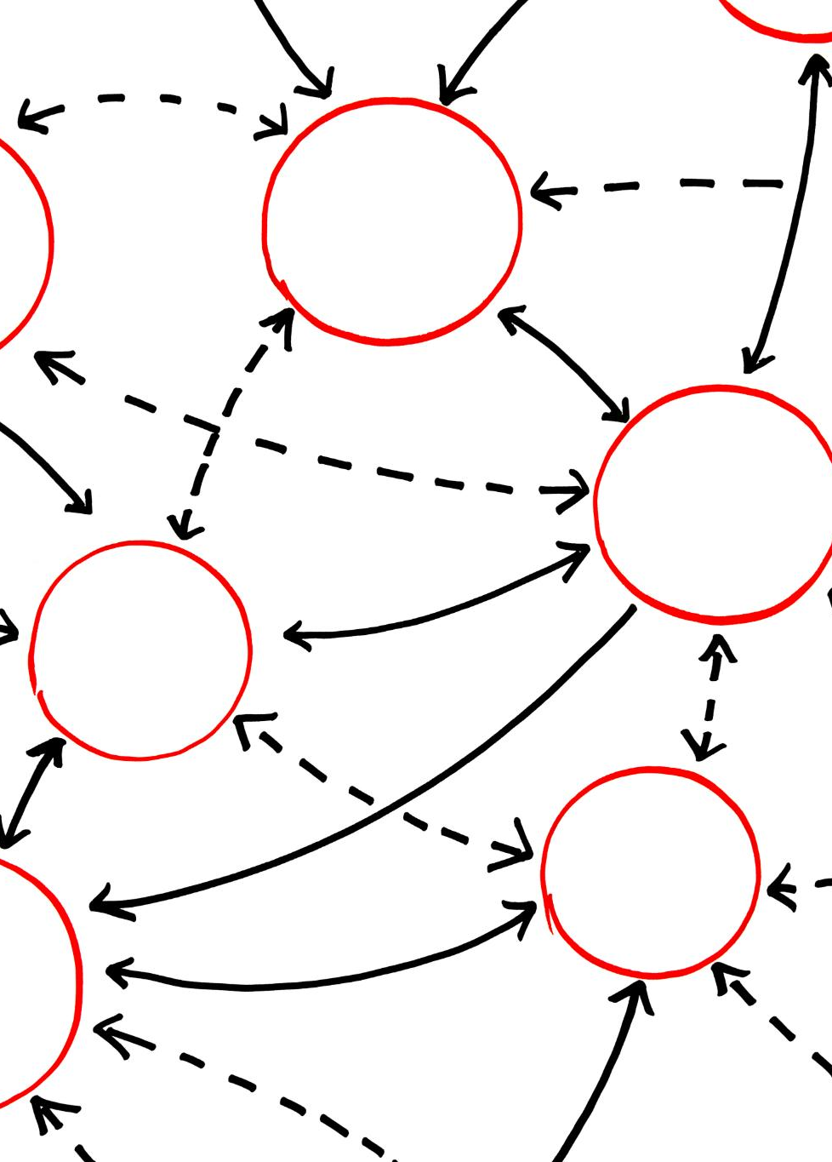
Data Splitting and Cross Validation
Data Splitting Methodology
Initial split: Male dater responses & Female dater responses
Second split: 80:20 split into training and testing data
221 Training observations
55 Test observations
NOTE: Totals do not account for observations dropped due to missing values
Cross Validation Process
Prediction models developed on training data sets
Models tested on test data sets
Ensures model is not over-fitted to data
Allows for adequate predictions after introduction of new data

Slide 10
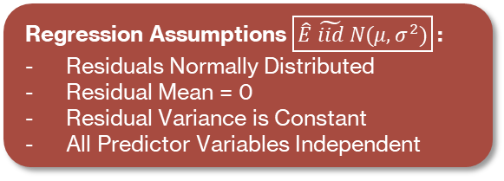
Prediction Model Development Process
Regression Assumptions $\boxed{\hat{E} \tilde{iid} N(μ, σ^{2})}$:
Residuals Normally Distributed
Residual Mean = 0
Residual Variance is Constant
All Predictor Variables Independent
Male Model
Female model
Pre-model creation checks
Attractiveness indicated as potentially present in 2nd order
Pairwise interactions included
Initial model
Violated regression assumption of normal residual distribution & homoscedasticity (standard variance)
Final Model
Like score squared to ensure standard variance & improve normal distribution
Stepwise forward selection utilized
Ensures variables dropped if significance changes as model grows
Calculated shrinkage (0.0623) indicates reliable model
No collinearity identified
Pre-model creation checks
Only single order terms identified
Pairwise interactions included
Initial Model
Violated regression assumption of normal residual distribution & homoscedasticity (standard variance)
Final Model
Like score squared to ensure standard variance & improve normal distribution
Stepwise forward selection utilized
Ensures variables dropped if significance changes as model grows
Calculated shrinkage (-0.0659) indicates reliable model
No collinearity identified
Like_{M}² ~ Fun + (Attractiveness * Sincerity) +
(Attractiveness * Shared Interests) + Intercept
Like_{F}² ~ (Attractiveness * Fun) + (Sincerity * Intelligence)
(Intelligence * Shared Interests) + Intercept

Slide 11
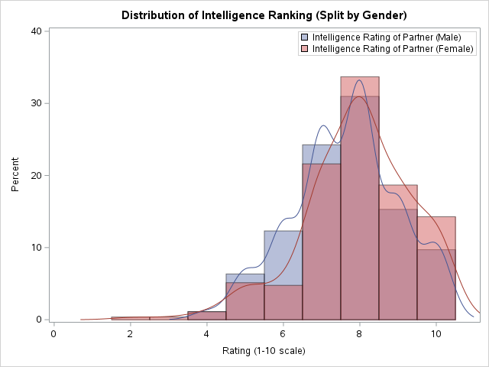
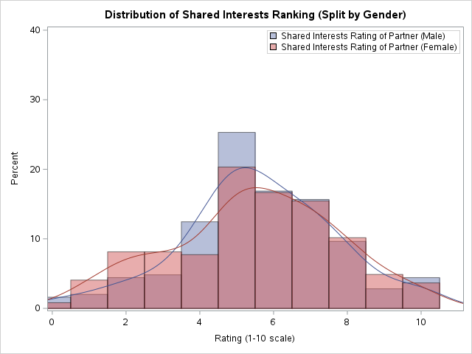
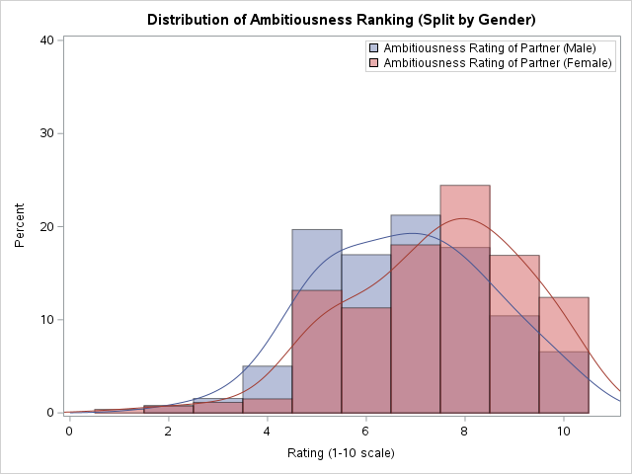
Men vs. Women The age-old comparison
Purpose of splitting data by participant gender:
Identified clear distribution differences in all characteristic ranking values
Allows for unique matching approaches
Acknowledges preferences are not one-size fits all
Male preferences:
Fun, Attractiveness (twice!), Sincerity, Shared Interests
Female Preferences:
Attractiveness, Fun, Sincerity, Intelligence (twice!), Shared Interests
Takeaway:
Both genders value: fun, attractiveness, sincerity, & shared interests
Men value attractiveness more than women (present in 2 pairwise interactions)
Women value intelligence more than men (present in 2 pairwise interactions & missing from male model)
Men vs. Women The age-old comparison
Notes:
The data was split into two groups for analysis: male and female, as it has been previously determined that each gender may prioritize different characteristics when selecting a potential partner. The distribution of the personality characteristic variables are included below in Figure 1 with the scores recorded by male participants being represented in blue while the scores recorded by female participants are represented in red.

Slide 12
Summary of Findings

Slide 13
Findings and Recommendations
Gender-Specific Preferences
Males value attractiveness at a greater rate than females
Data Integrity Recommendations
Enhancing User Experience
Enhance user experience using the following approaches:
Develop imputation procedures to predict observations for blank values
Females value intelligence while males do not
Remove options for participants to leave responses blank
Blank values can skew prediction models resulting in inaccurate predictions & incompatible dater pairings.
Options to fix:
Aggregate characteristic rankings across multiple evaluations for pseudo peer-review
Allow for minimum predicted like ranking cutoffs for matches
Re-evaluate age groupings to determine if dater age impacts desired characteristics

